Slide 1
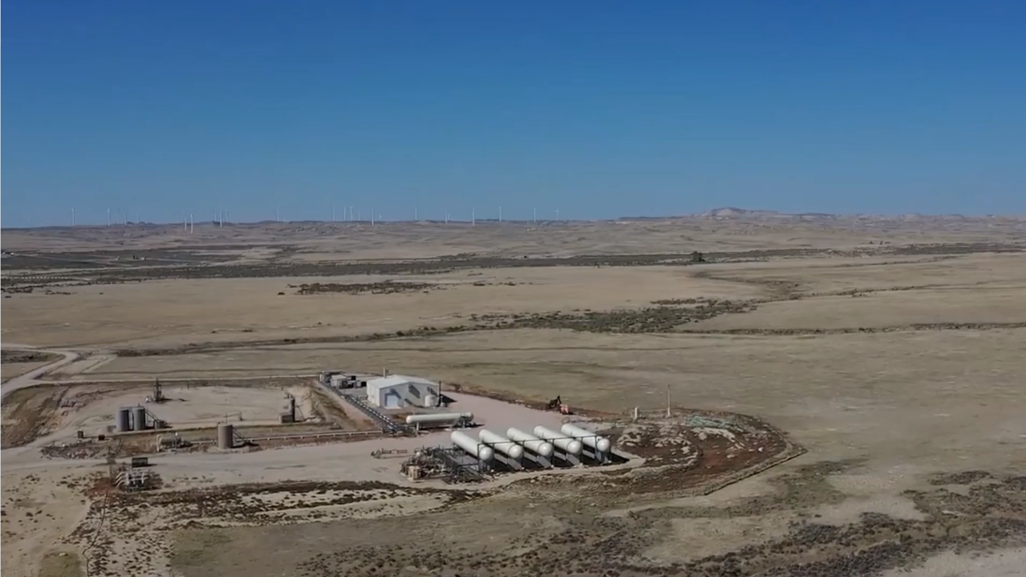

COPL Annual Meeting
Presentation
May 30, 2023

Slide 2
2022 Highlights
35.7% increase in Proved plus Probable (2P) Reserves though Cuda acquisition at a cost of $1.86/Boe
  December 31, 2021 Proved plus Probable (2P): 29,291 Mboe.
  December 31, 2022 Proved plus Probable (2P): 39,735 Mboe.
  (Note: the Reserves do not include c.4.5 Bcf of Injectant in place in the reservoir)
Completed the acquisition of the Cuda assets through a Bankruptcy process in July 2022 for $19.4 million.
  (Note: COPL through the Atomic and Cuda acquisitions purchased the assets at c.75% of cost)
Cuda Insolvency/Bankruptcy caused the Company to carry the Cuda working interest obligations from the Atomic acquisition (March 2021) to through to the end of the Bankruptcy process (July 2022).

Slide 3
2022 Highlights
The Company’s performance was negatively impacted by the following:
  Cuda Insolvency/Bankruptcy caused the Company to carry Cuda’s operational arrears which reached a maximum of c. $5 million causing liquidity issues to the Company’s Senior Credit facility.
    The Cuda Receiver would not utilize funds from the Court authorized DIP funds though the Company was a secured 1st Creditor.
  Hedging losses on the hedges required under the Senior Credit facility due to unexpected dramatic increase in oil prices due the Russia/Ukraine conflict.
  Increased Interest cost on the Company’s Senior Credit facility due to dramatic increases in interest rates as a response to inflation in the western economies.
  Oil production decrease at the Barron Flats Shannon Unit due to decrease in injection volumes in February 2022 to mitigate pressure restrictions in the gas gathering system due to increased field operating pressures caused by injection response.
    The Company was unable to implement a solution to these issues due to the inflexibility of its Senior Credit facility and its 27% working interest partner (Cuda) being in Receivership commencing in November 2021.

Slide 4
2022 Operations Summary
BFSU Miscible Flood in 2021-2022 was showing an overall better than expected production response.
The production response caused certain wells to exhibit unexpected very high working pressures. This exposed inadequacies in gas gathering system and wellsite and Production Battery facilities. This caused the following:
  Reduced injection volumes and solvent % commencing in February 2022 to take the pressure off of the system which resulted in a decrease in production volumes due to reduction of drive.
  Reconfigure certain pumping wells with high pressures, to flowing wells.
  A number of HSE incidents: fires and well control issues.
  A full top to bottom re-evaluation of the field from reservoir to production facilities.
  Engineering of a high pressure and volume gas gathering system with accompanying changes to well site facilities to handle increased pressures to augment existing low pressure system.
  Application for “gas flaring” to the regulator to temporarily take pressure off of the system. Production increases expected were limited by well site facilities and high wellhead pressures.

Slide 5
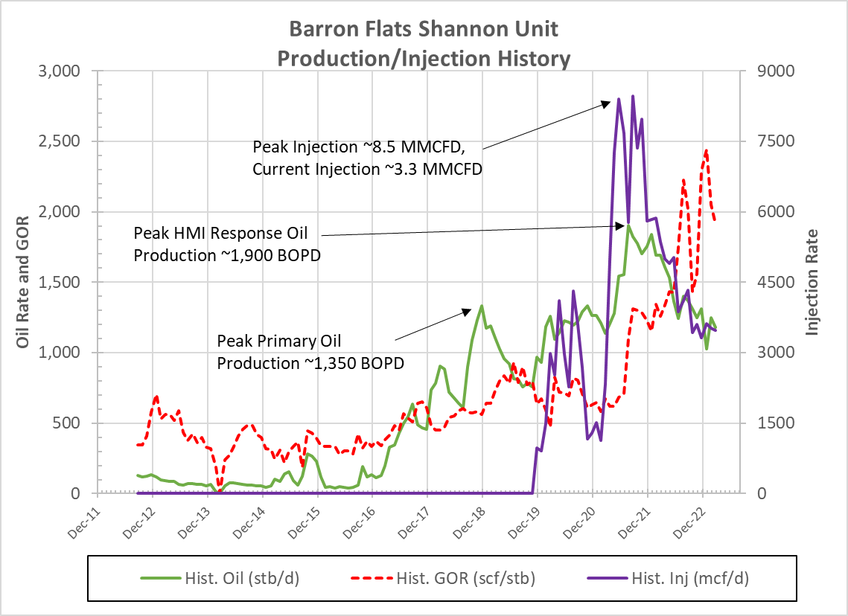
A
B
C
D
A: Atomic Purchase and Commencement
of Gas Injection
B: Reduction in Gas Injection Volumes and
Leaning of Injectant Due to Increases
in Field Operating Pressures
C: Commencement of Pressure Issues
on Four Pumping Wells Q2 2022
D: Pressure Issues at a Pumping Well
Responding to Miscible Flood
A-B: Q2 2021-Q1 2022 Production Rise
Due to Miscible Flood Response
B-D: Q1 2022-Q2 2023 Production Drop
Due to Reduced Injection Volumes to
Control Operating Pressures
Note: Cuda Insolvency/Bankruptcy
Q2 2021 to Q3 2022

Slide 6
Operating Cost Issues Related to Reduced Injection and Miscible/Lean Gas
Increased Paraffin Remediation Costs
  All Powder River Basin Crude Oil is Paraffinic
  BFSU Crude is 42° API, 6% Paraffin, C.P. 75° F
  Treatments: Hot Oil, Condensate Washes/Squeezes, Chemicals
Significant Increased Operating Costs in Q3 and Q4 2022
  Due to Workovers and Paraffin Remediation
  Paraffin Plugging of Flowing Wells (best producers) caused considerable production downtime from high rate producing wells.
The Miscible Flood Appears to Have Changed the Behavior of the Paraffin, with 4 different paraffins observed.
Solution: Convert the Flowing Wells to Pumping Flowing Wells.

Slide 7
FY 2022
Total Field Operating Expenses

Slide 8
FY 2022
Total Field Operating Expenses
Work Over Costs Detailed

Slide 9
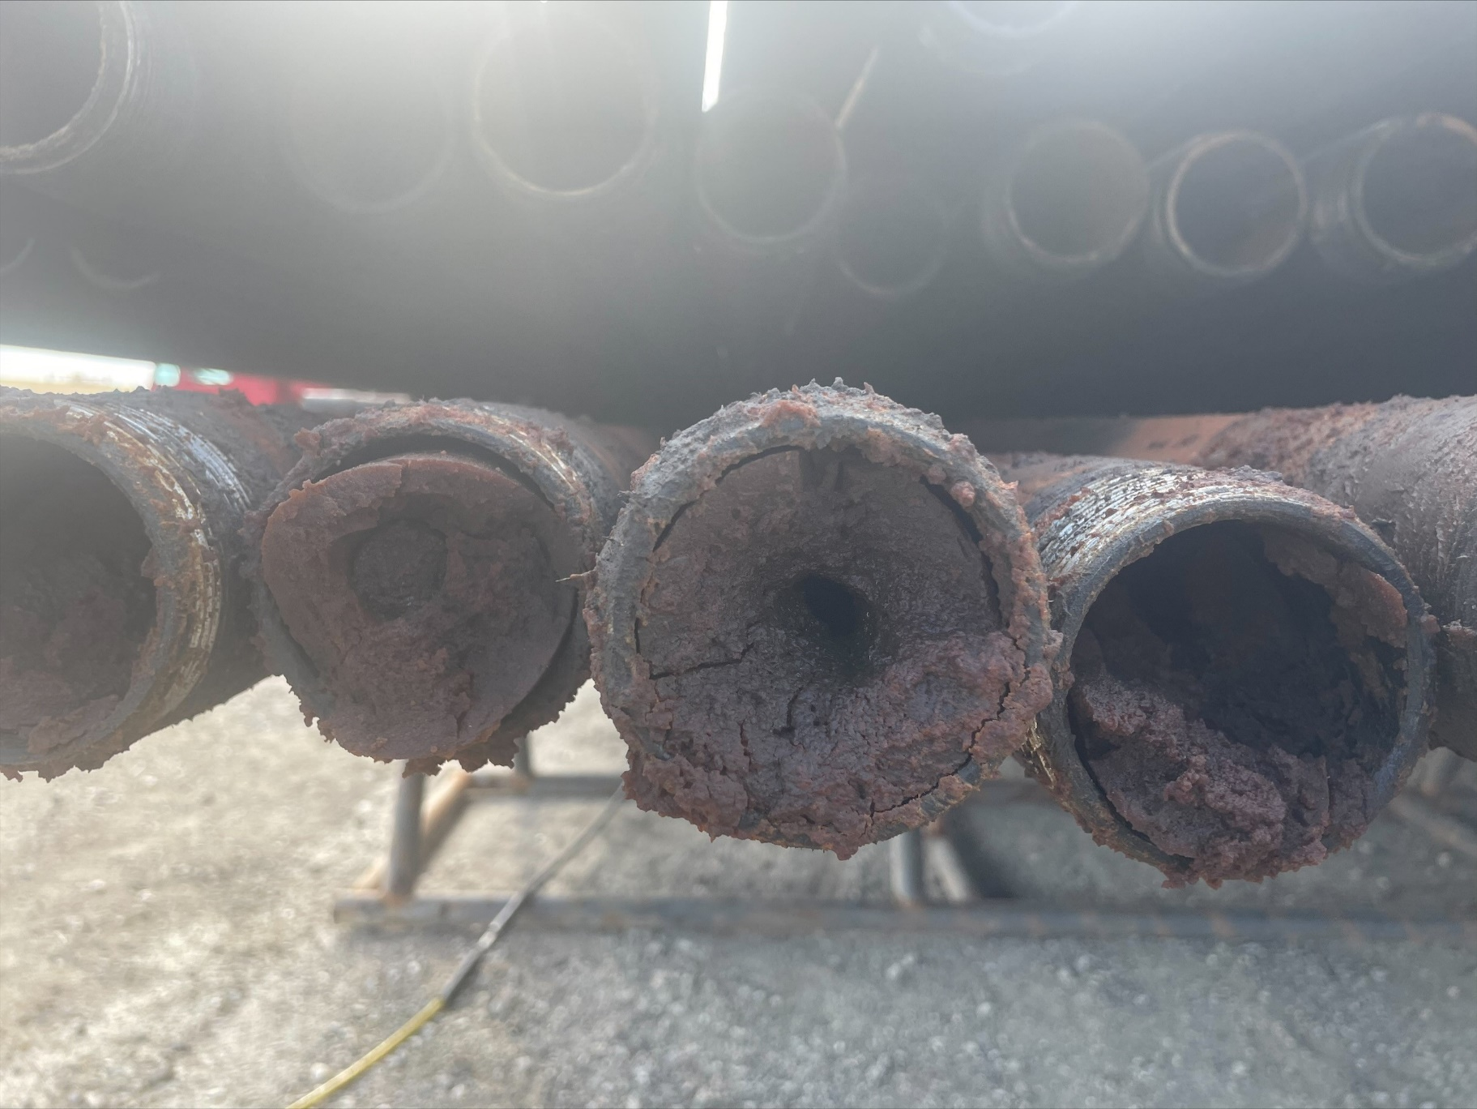
Paraffin Plugged Tubing
(Extreme: Pump to Surface)

Slide 10
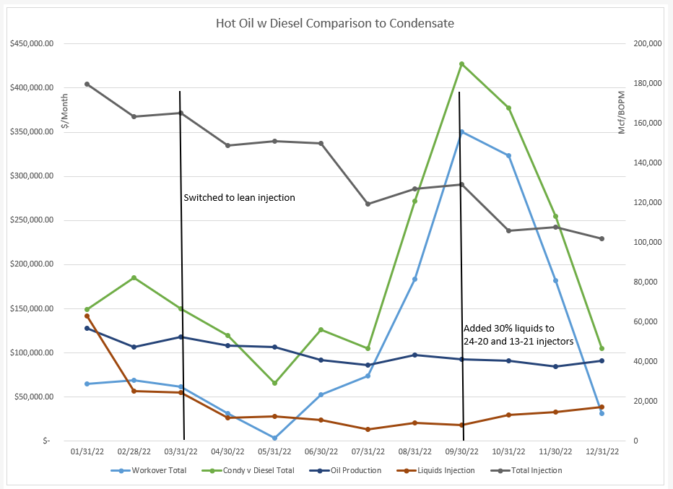

Slide 11
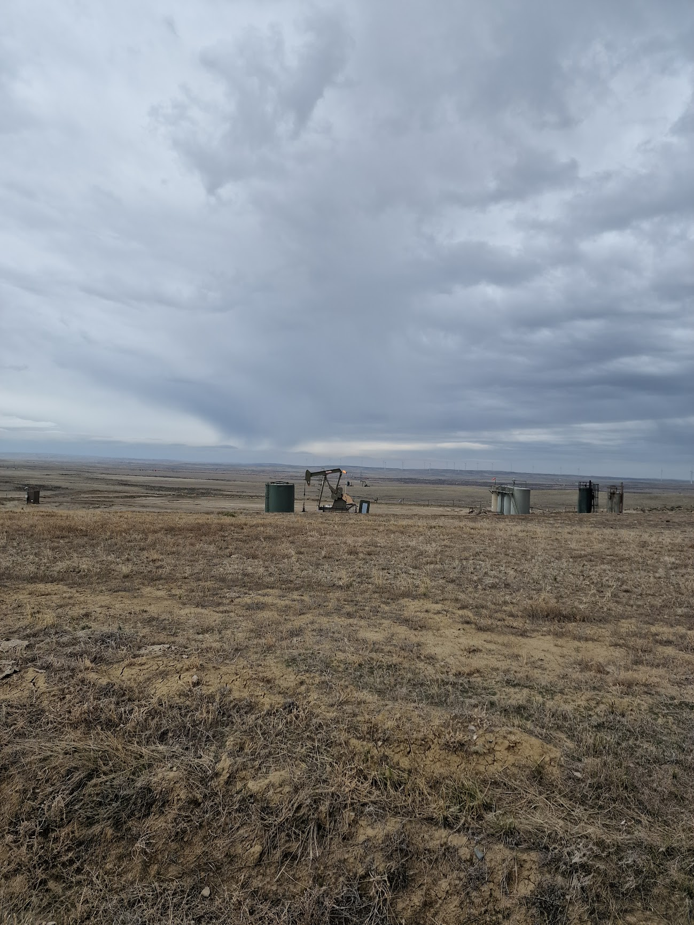
BFSU Field Terrain

Slide 12
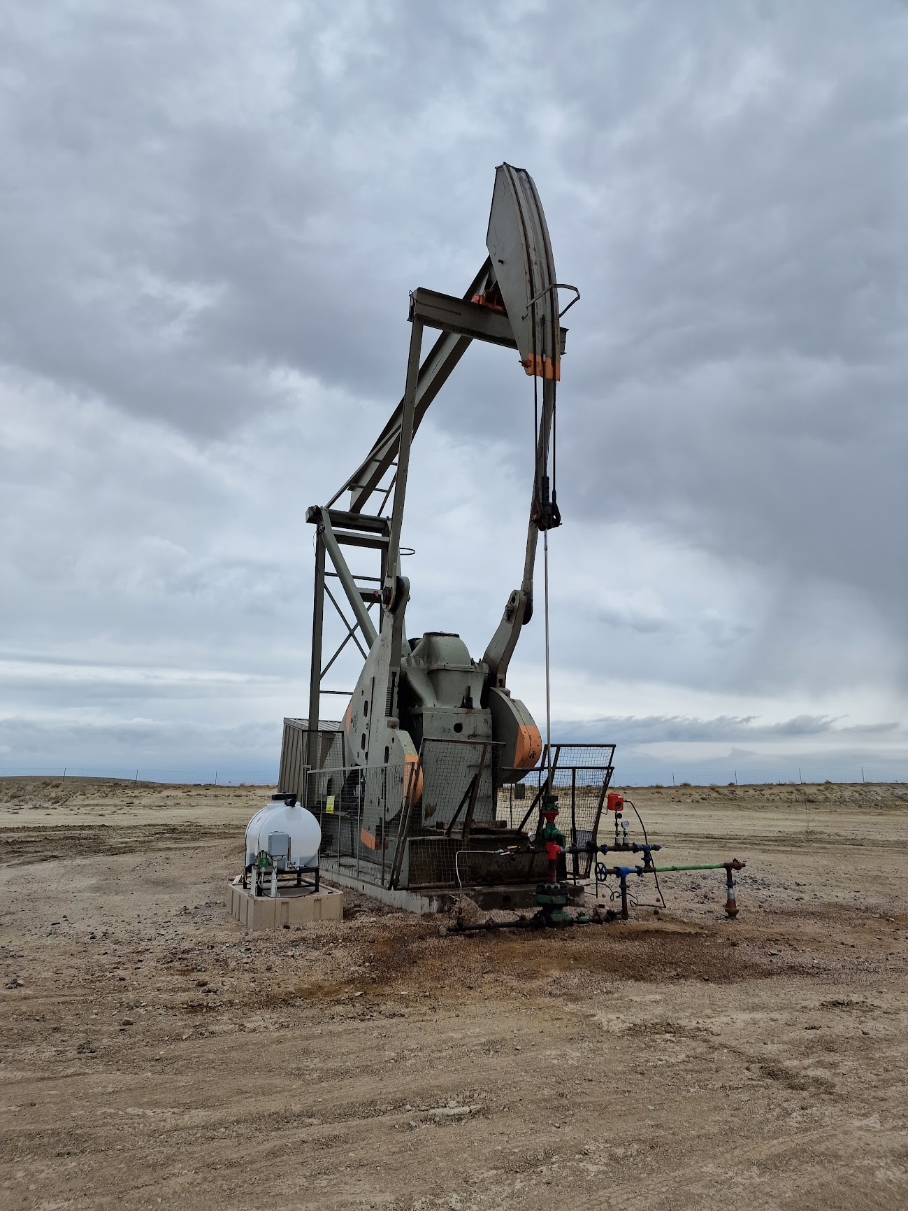
Typical BFSU Pumping Well
Standard Pumping Wellhead

Slide 13
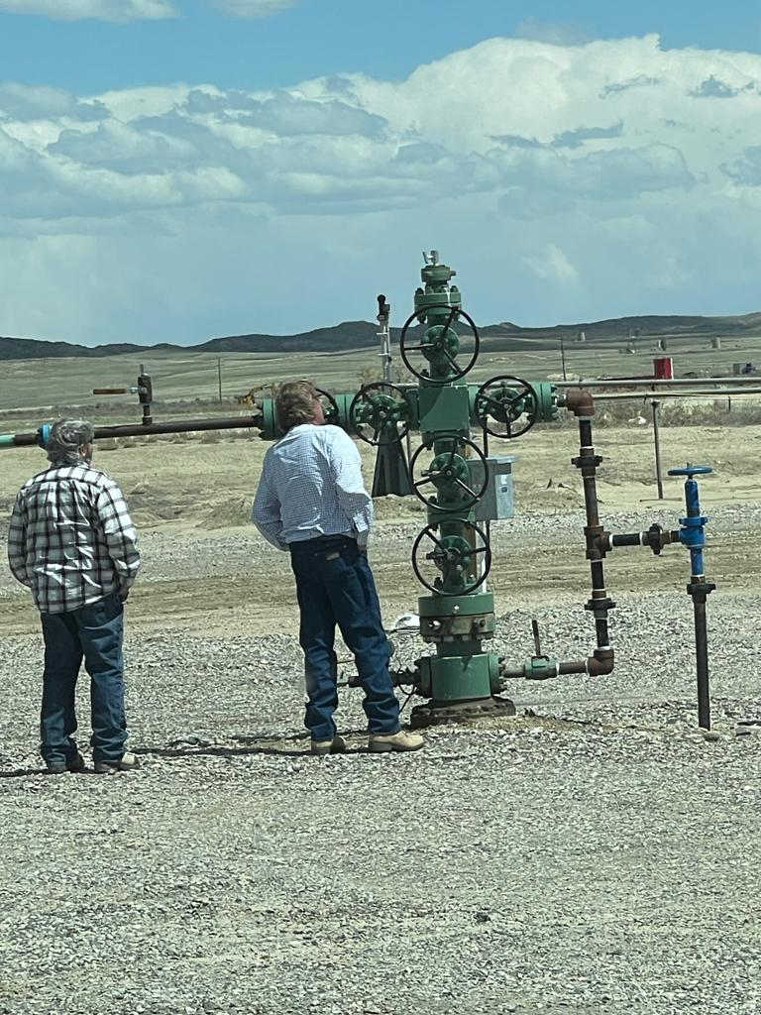
Typical BFSU Injection Well,
and/or Flowing Well Configuration
5,000 psi rated

Slide 14
Critical Operational Issues 2022 to Present
Nine (9) critical well killing operations with high working pressures and high pressure differentials (up to > 1,450 psi) tubing/casing pressures.
Eight (8) Coil Tubing interventions on flowing wells to remove paraffin plugs with high pressure differentials (>1,000 psi) across the wax plug.
Seven (7) fires at wellsite facilities caused by high pressure (estimated c. 1,000 psi) gas bubbles transiting through the production facilities and extremely volatile crude oil due to entrained Butane from miscible injection.
One (1) loss of control during an well kill attempt on a pumping well during conversion to a flowing well due to equipment failure on the wellhead and high working pressures (c. 1,200 psi) resulting in a uncontrolled flow of gas and oil.

Slide 15
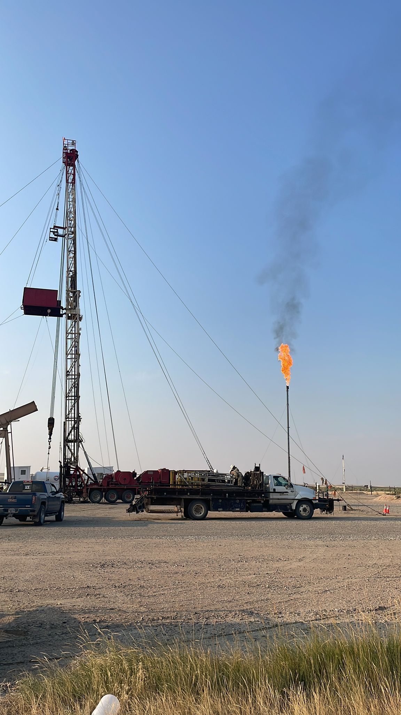
BFSU Pumping Well Kill Operation
September 2022
1,466 psi pressure differential
Tubing 34 psi
Casing 1,500 psi
Cause: Paraffin Plugged Pump and Tubing

Slide 16
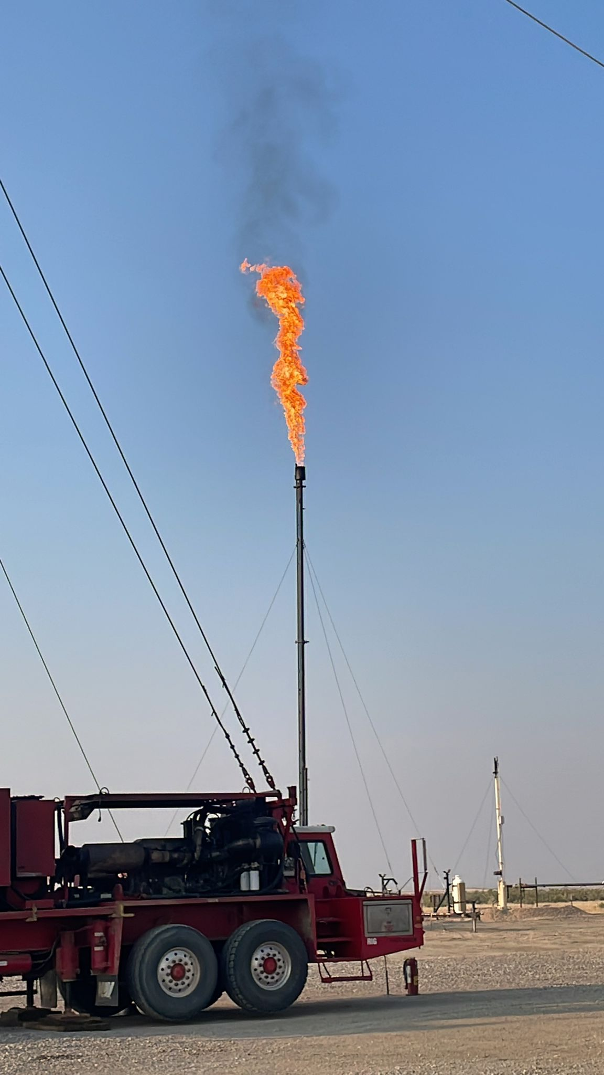
BFSU Pumping Well Kill Operation
September 2022
1,466 psi pressure differential
Tubing 34 psi
Casing 1,500 psi
Cause: Paraffin Plugged Pump and Tubing

Slide 17
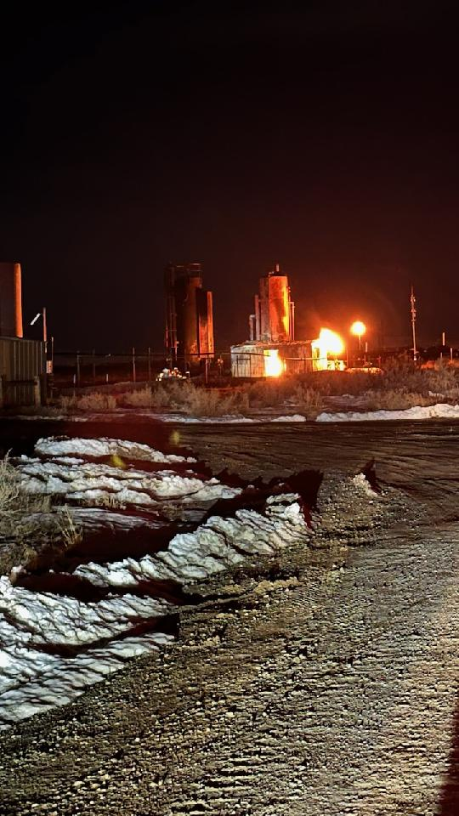
BFSU Production Battery Fire
April 9, 2023 1:50 am
Cause: Gas Bubble from a pumping well
Cause: Pumping well miscible response
Estimated Pressure: >1,000 psi

Slide 18
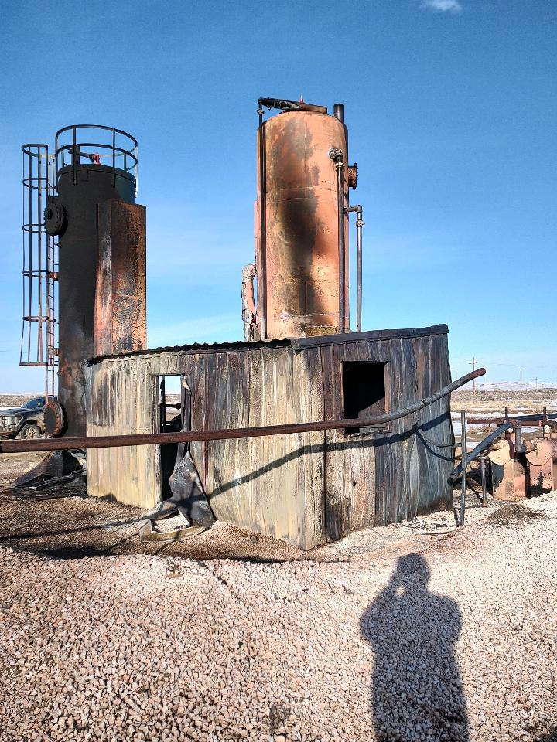
BFSU Production Battery Fire
April 9, 2023
Treater-Separator Damage
Cause: Gas Bubble from a pumping well
Cause: Pumping well miscible response
Estimated Pressure: >1,000 psi

Slide 19
Operational Issues: Solutions
Upgrade the BFSU Gas Gathering System (“GGS”) with a high pressure-high volume trunk line through the field to handle produced gas (injectant) for recovery and re-injection through the BFSU Gas Plant.
Upgrade wellsite facilities with the installation of high pressure rated (5,000 psi) wellheads and pumping tubing heads.
Upgrade the Production Batteries associated with critical wells with high pressure separators (1,440 psi) to handle high pressure gas influx.
Upgrade the Production Batteries with high pressure separators (720-1,440 psi) performing as predicted on simulation to handle expected high pressure gas influx.
Number of wells: 16; Number of Production Batteries: 8

Slide 20
2023 OPERATIONS OBJECTIVES
Decrease Production Down Time
Increase Operating Efficiency
Reduce Operating Costs
Eliminate Serious HSE Incidents
Maximize Oil Production: Return to Miscible Injection
  Shannon Unit Reservoir Management
  Evaluating Shut-In wells at Cole Creek
  Cole Creek Re-Completions
  Cole Creek Frontier Joint Venture

Slide 21
BARRON FLATS SHANNON UNIT
Q2 2023 FIELD UPGRADES

Slide 22
BFSU 2023 Upgrades Progress
Gas Gathering System construction commenced on schedule
  Budget: $4.5 million for pipeline and ungraded Wellsite/Production Battery facilities
  High Pressure wellsite facilities (separators) acquired in Alberta, Canada in response to supply chain issues in the US.
Three (3) flowing to high pressure flowing pumping well conversions completed.
  Paraffin treatment programs being evaluated and implemented.
  Positive production response observed.
One (1) conventional pumping well converted to high pressure pumping.

Slide 23
BFSU 2023 Gas Gathering Upgrades
Phase 1a

Slide 24
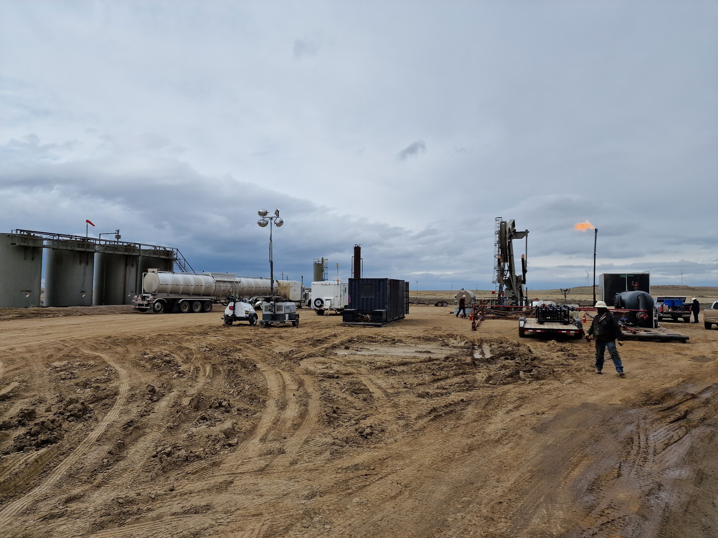
BFSU 34-20V Well Site
Post Conversion
Pumping to Pumping-Flowing

Slide 25
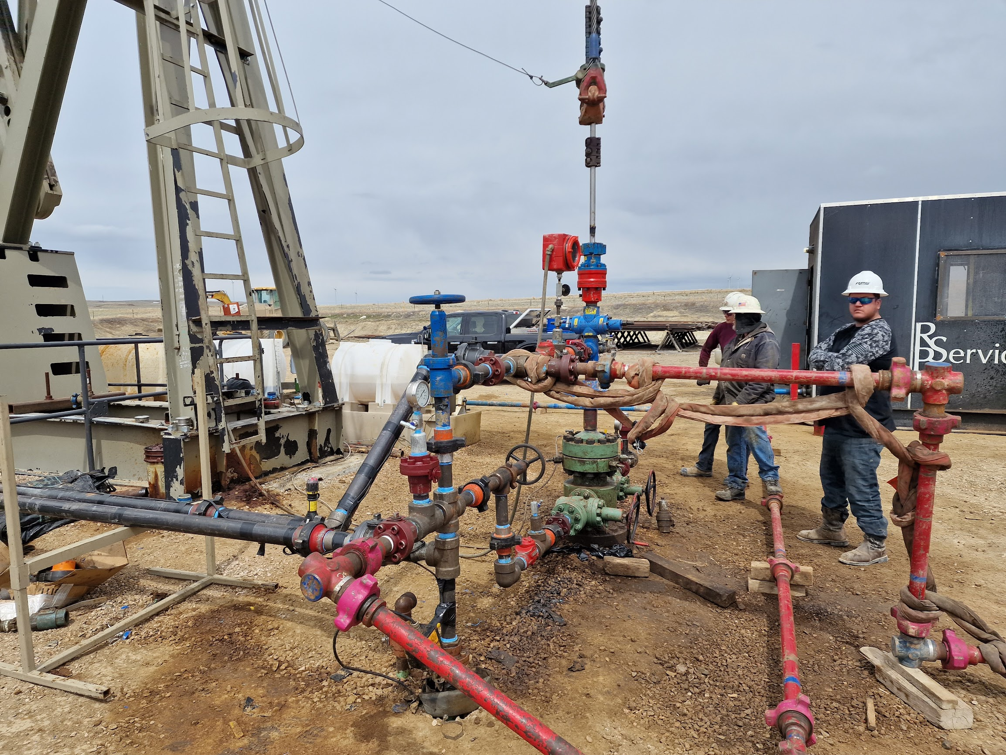
BFSU 34-20V Well Site
Post Conversion
Pumping to Pumping-Flowing
5,000 psi Pumping Wellhead

Slide 26
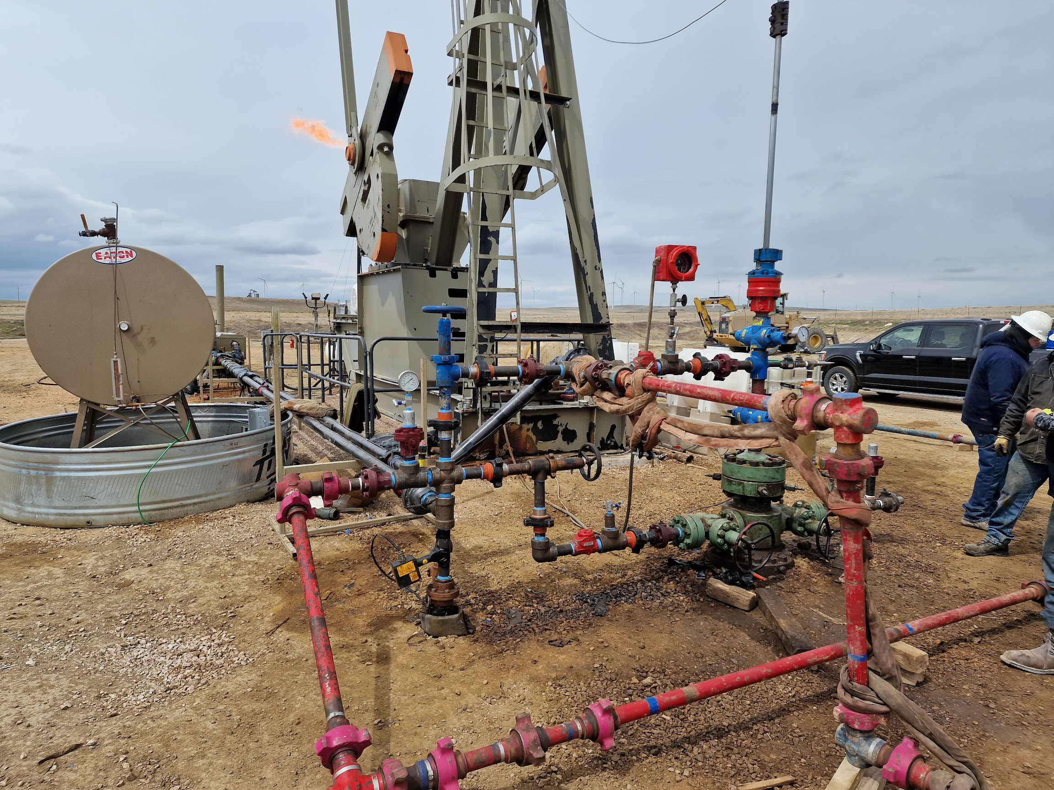
BFSU 34-20V Well Site
Post Conversion
Pumping to Pumping-Flowing
5,000 psi Pumping Wellhead

Slide 27
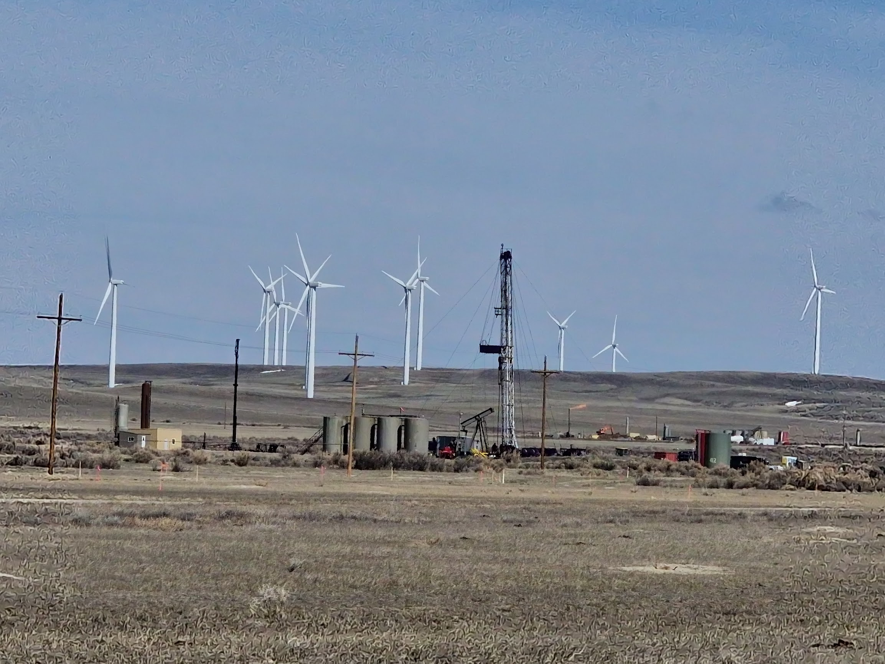
BFSU 44-21V Well Site
Conversion From
Pumping to Pumping-Flowing

Slide 28
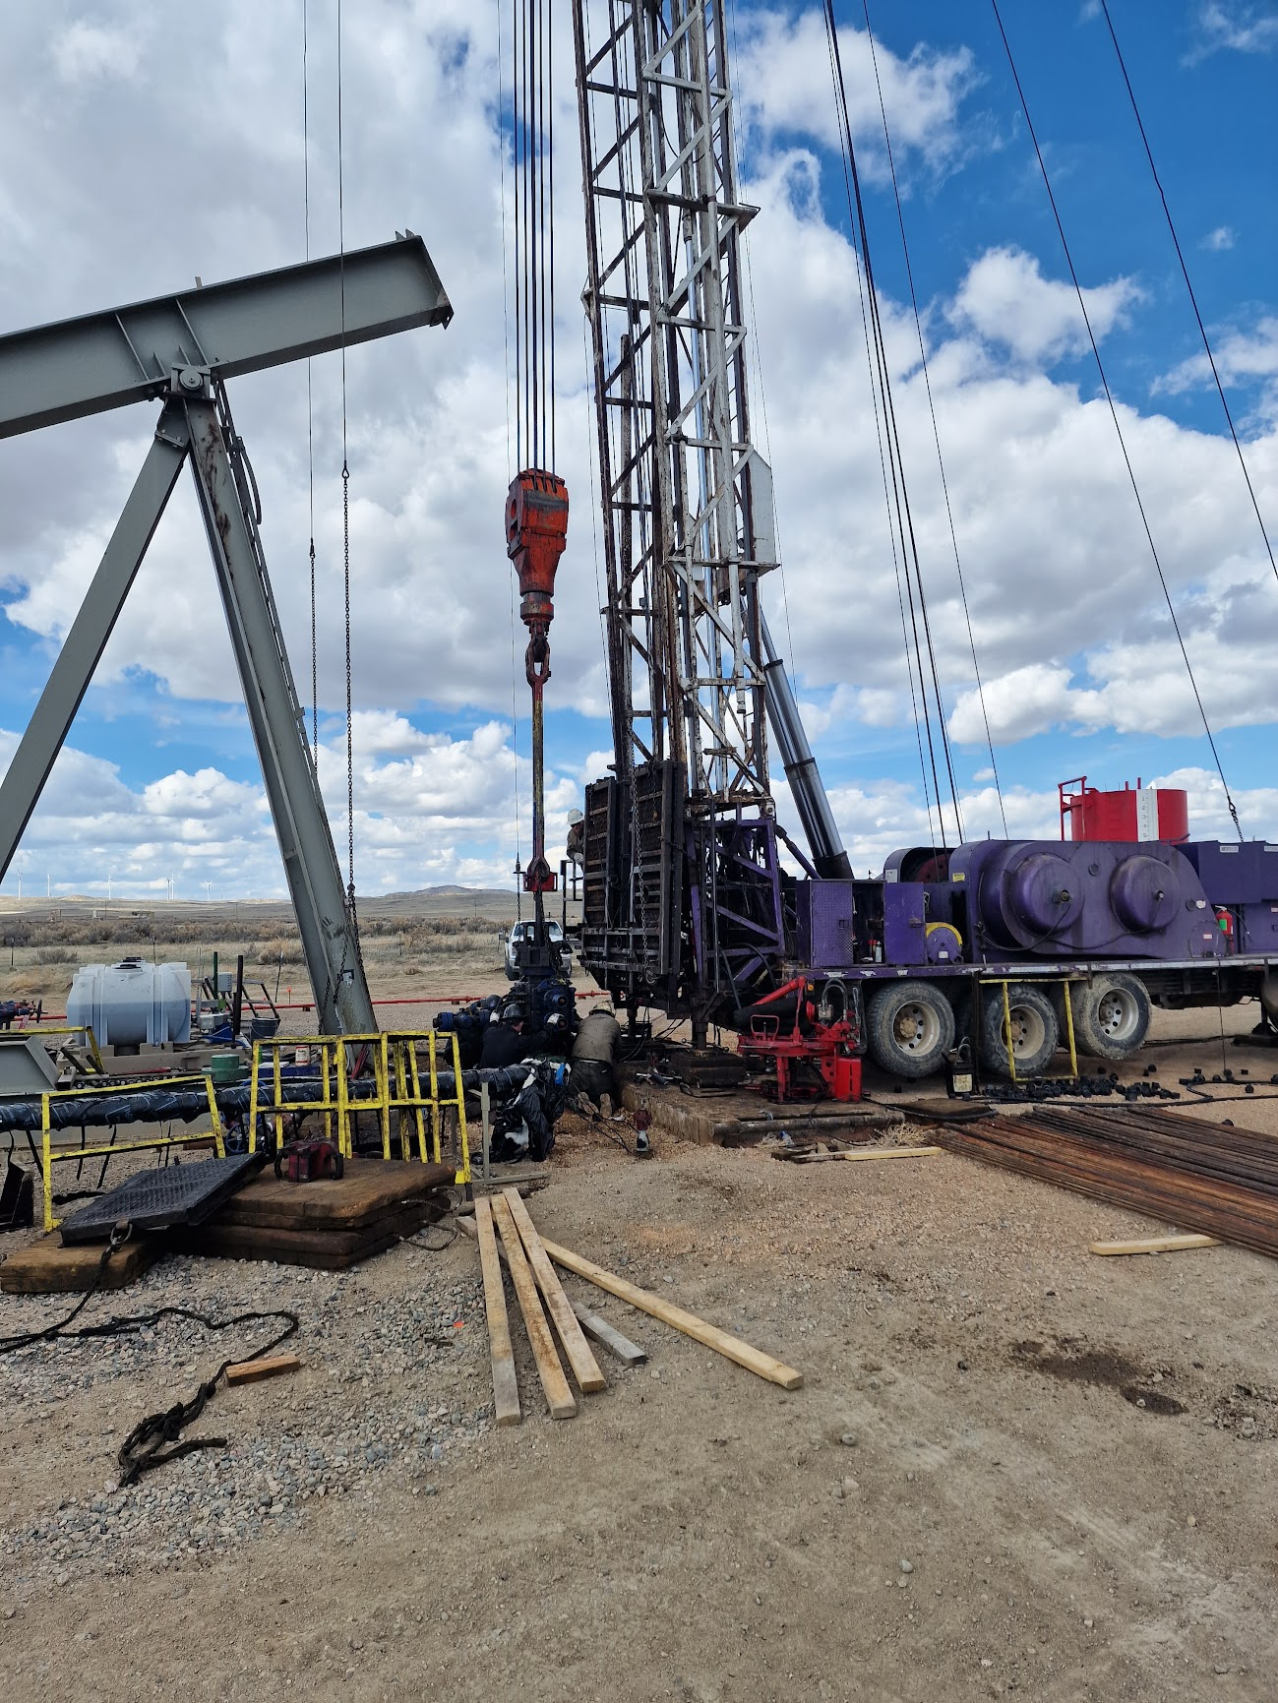
BFSU 44-21V Well Site
Conversion From
Pumping to Pumping-Flowing

Slide 29
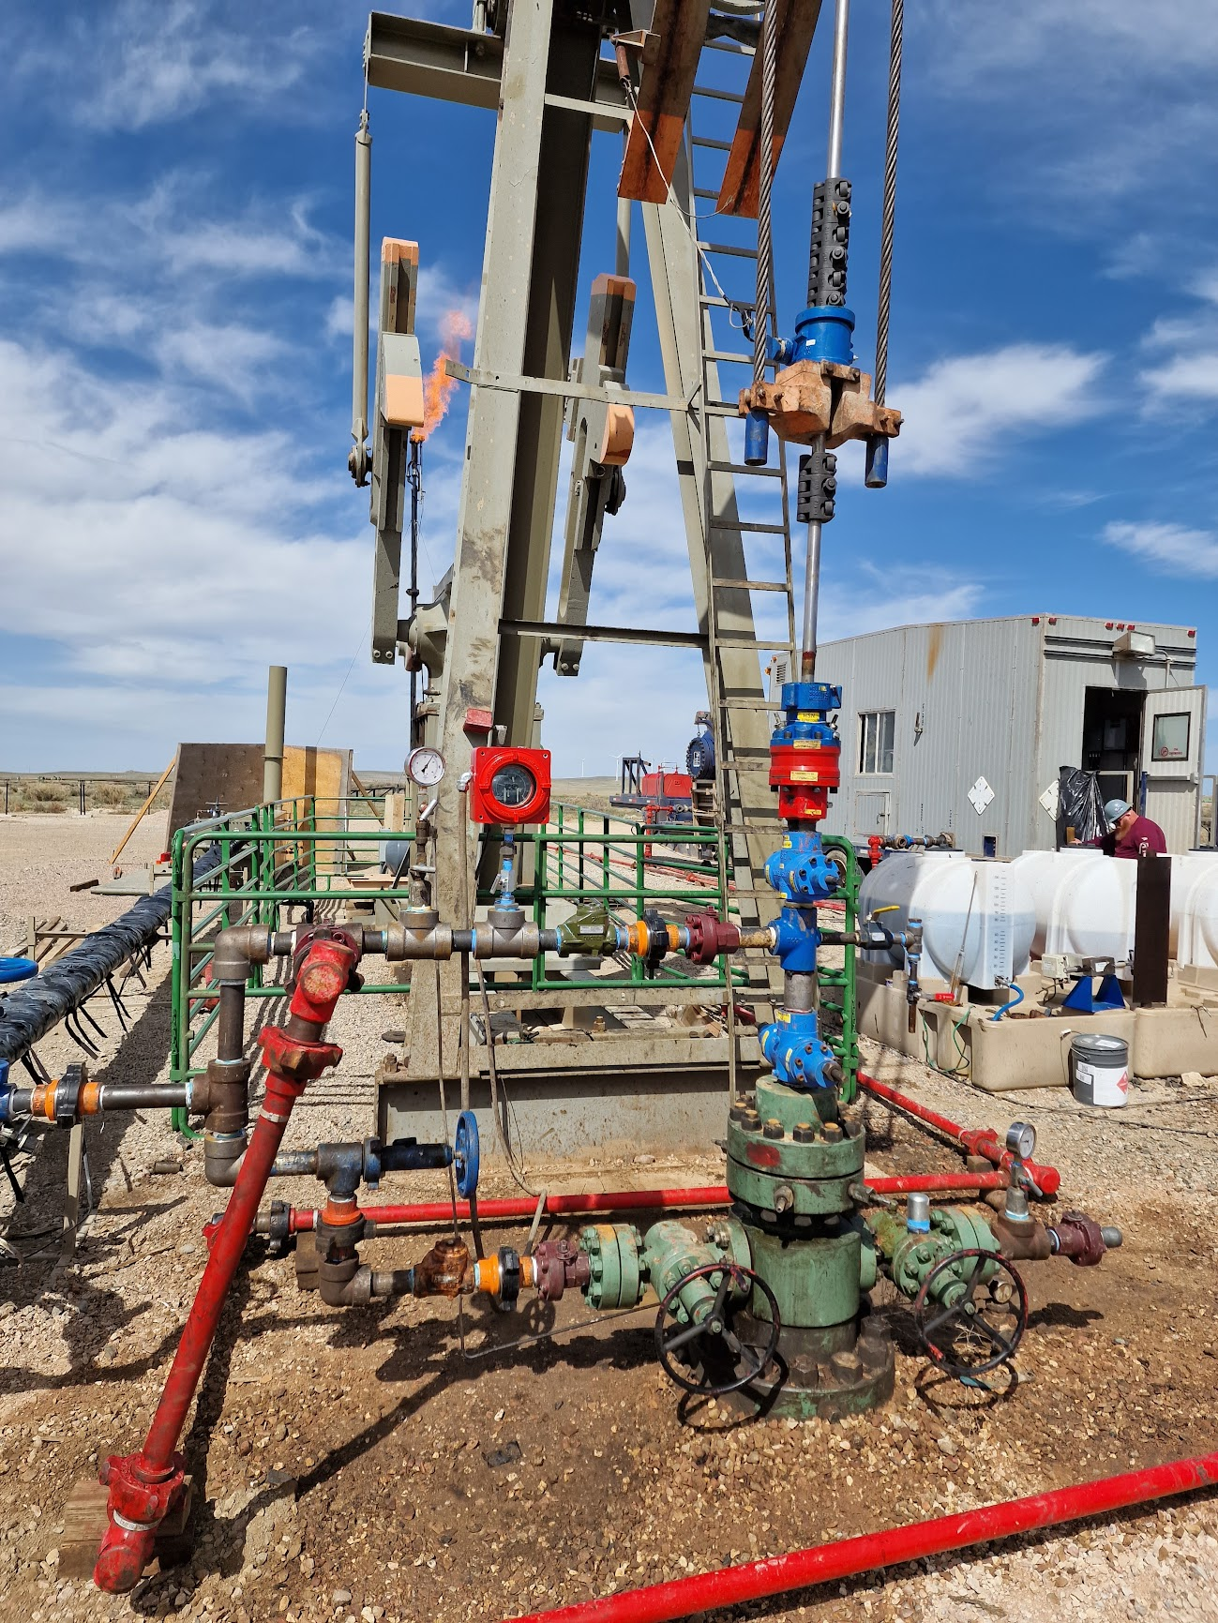
BFSU 44-21V Well Site
Post Conversion From
Pumping to Pumping-Flowing
5,000 psi Pumping Wellhead

Slide 30
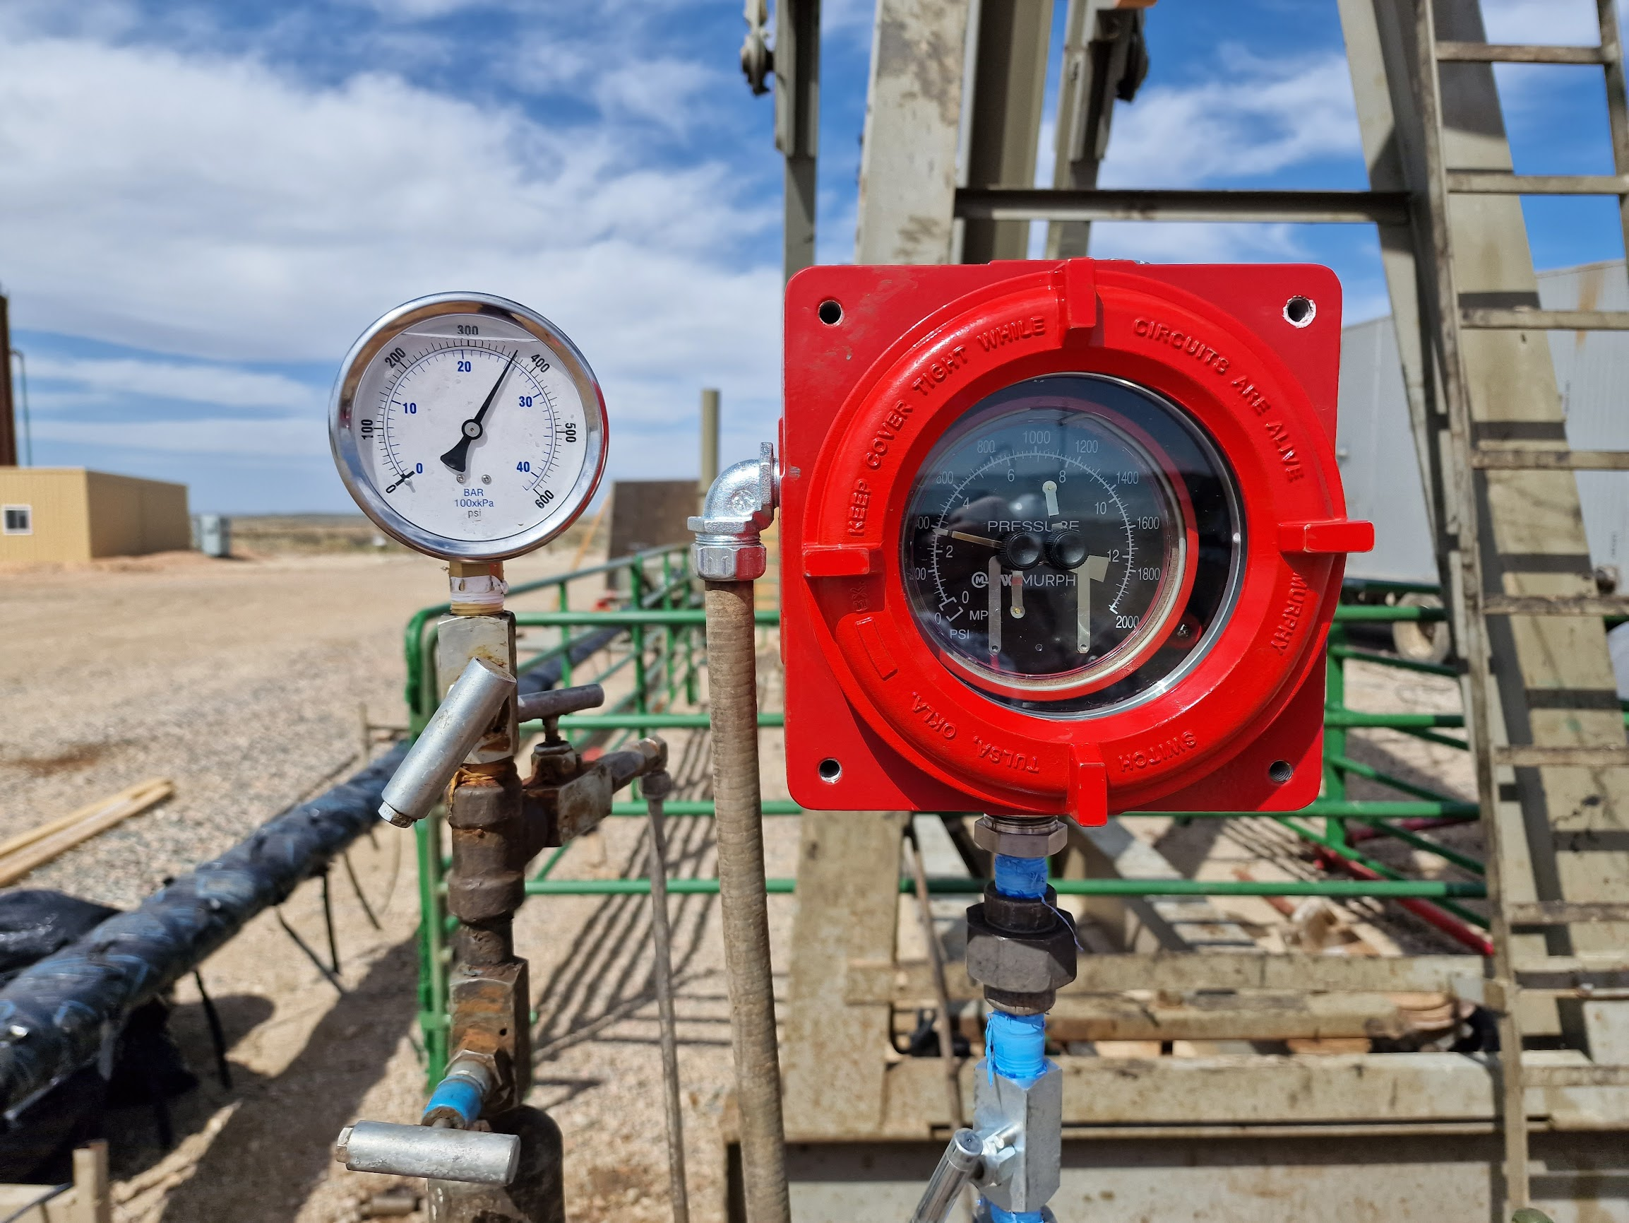
BFSU 44-21V Well Site
Post Conversion From
Pumping to Pumping-Flowing
Pumping Flowing Pressure:
360 psi

Slide 31
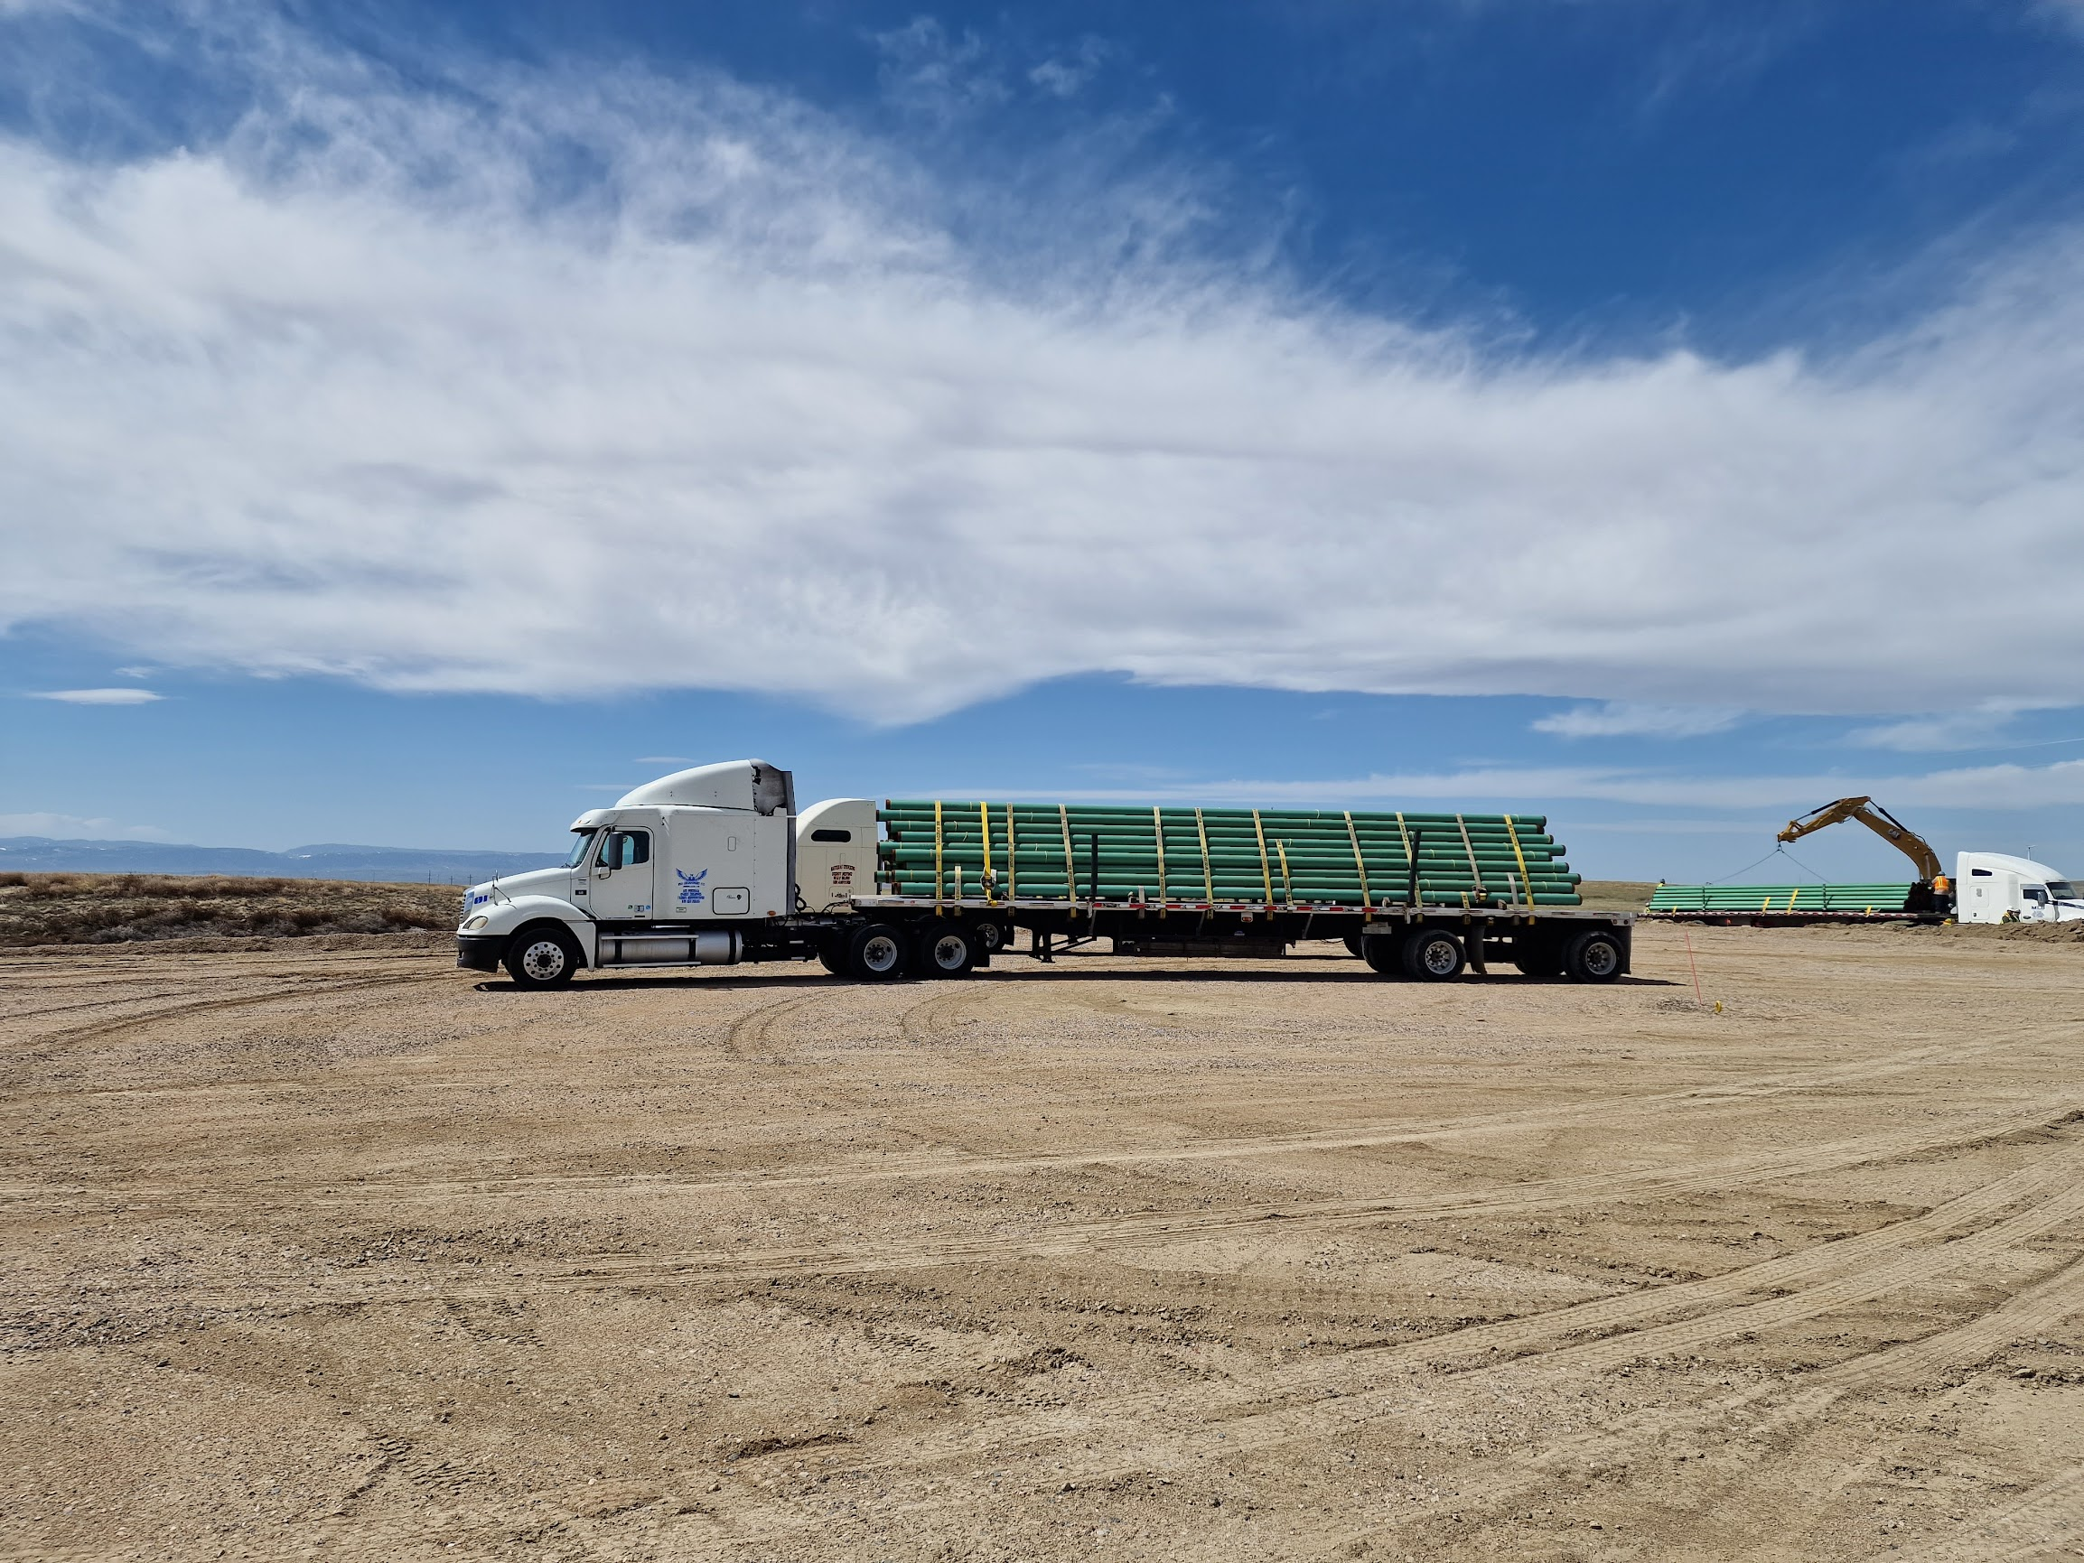
BFSU Gas Gathering System Upgrade

Slide 32
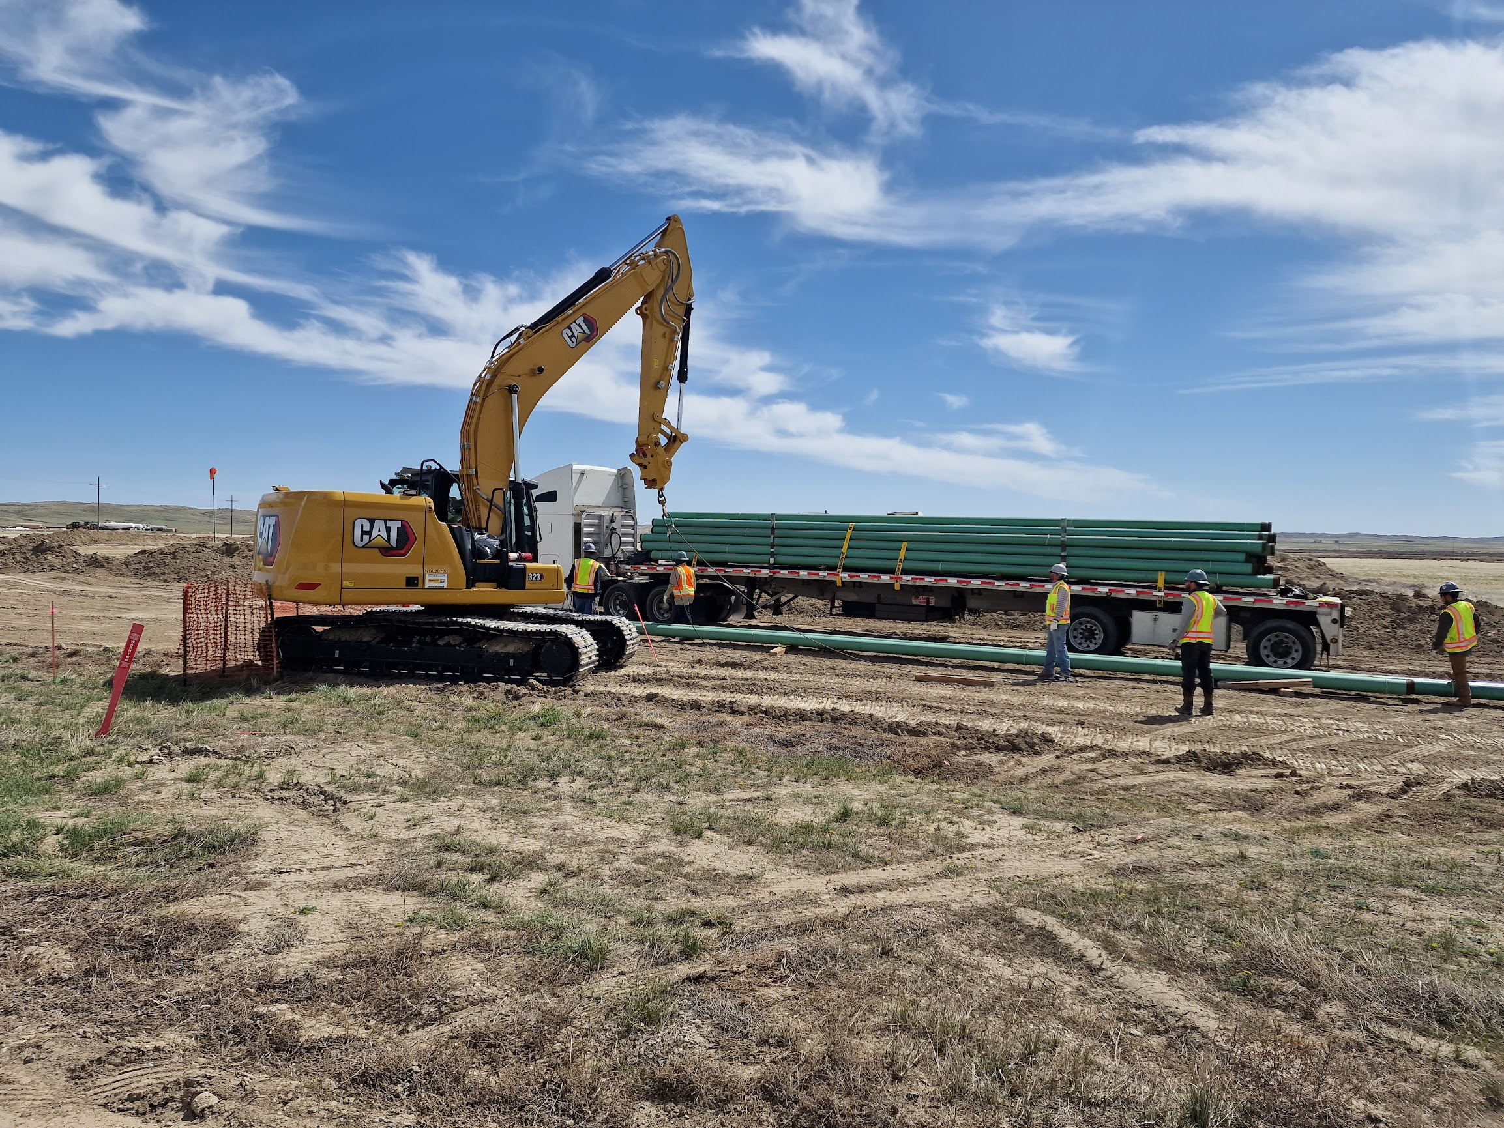
BFSU Gas Gathering System Upgrade

Slide 33
Production Rate Proportionate to 2020 Injection/Production
PP
Miscible Gas Injection Will Increase On Commissioning Of Gas Gathering And Wellsite Upgrades
Oil Production is Expected to Increase in Response as from Q1 2020-Q1 2022

Slide 34
Cole Creek

Slide 35
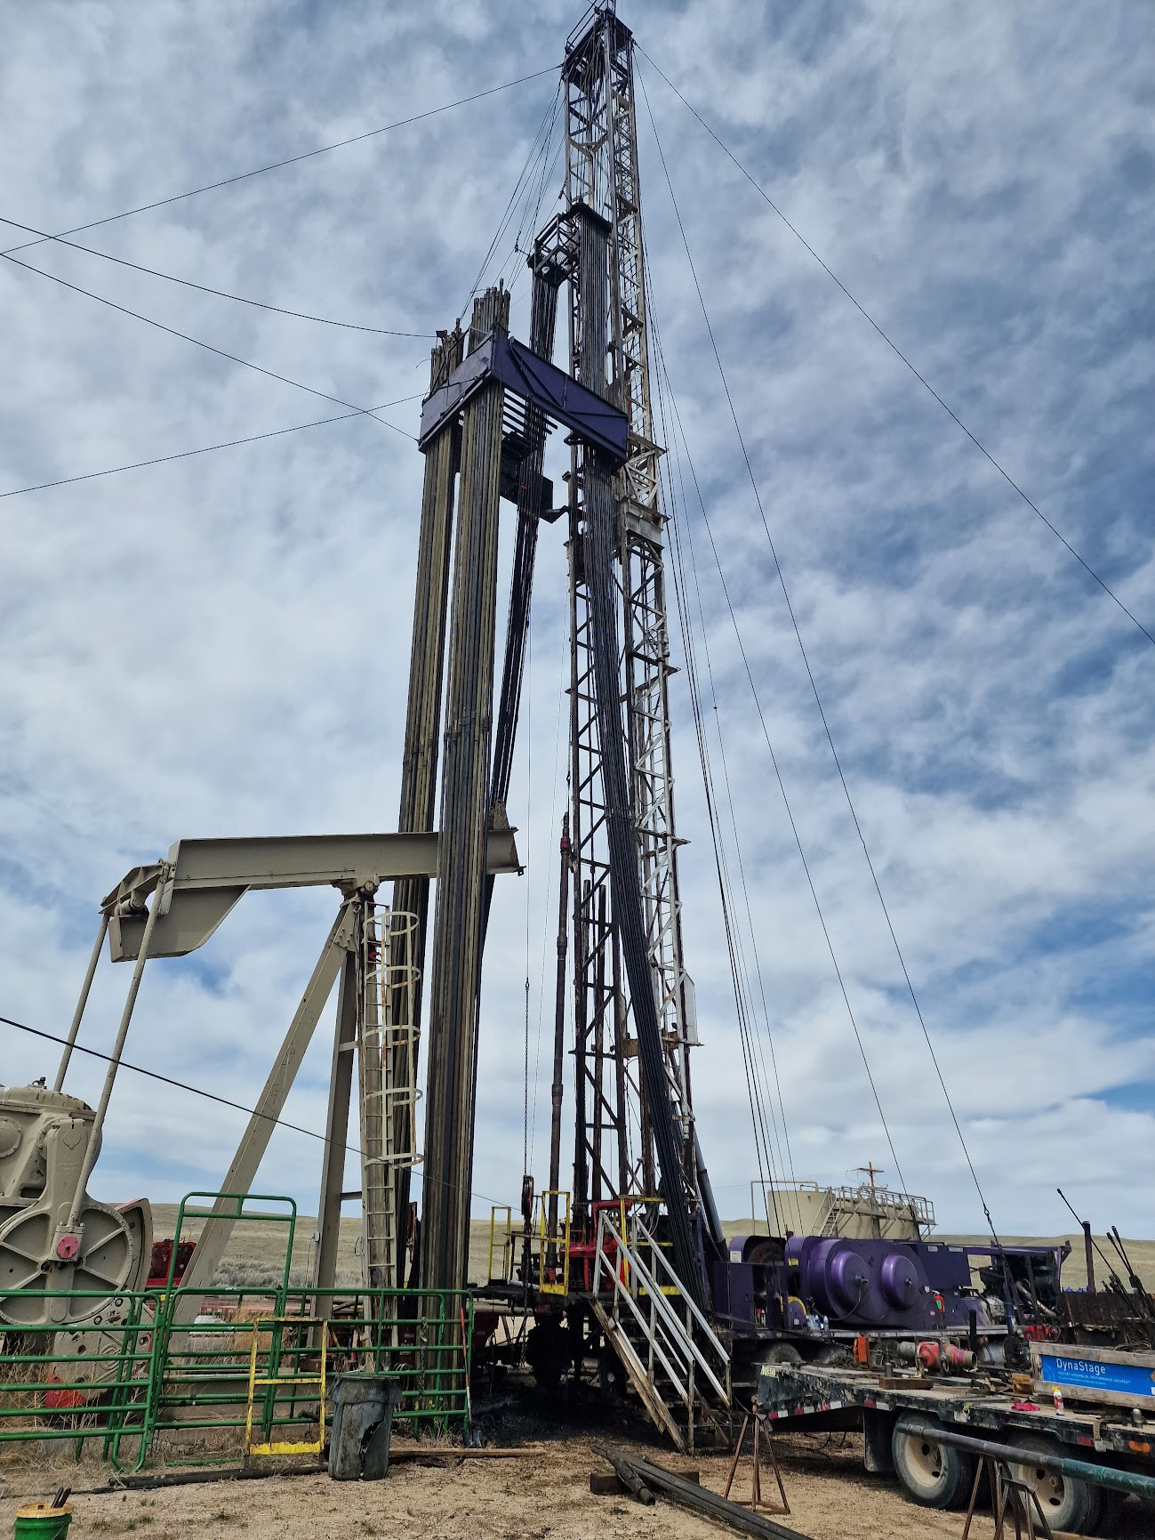
Cole Creek 12-23 Recompletion

Slide 36
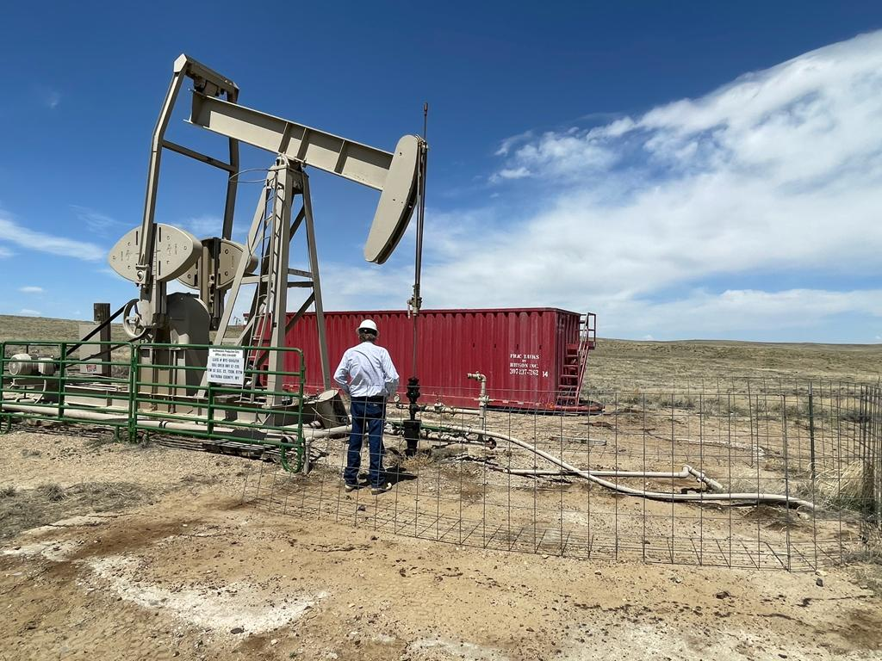
Cole Creek Upside
Shut-In Well >12 years
110 psi Tubing Pressure
Flowed 1 Bbl./Hr. on test
Currently Evaluating

Slide 37
Cole Creek Frontier Joint Venture
A large Oil Company approached COPL in September 2022 inquiring if we were interested in a partner to appraise and develop our Cole Creek Frontier oil resource.
This group has done substantial technical due diligence to date.
COPL has also done extensive additional technical work on the project.
Discussions/Negotiations are in progress on the terms and structure of a Joint Venture.
The objective of the concept is to end at an early stage EOR project similar in nature to the BFSU Shannon miscible flood.
COPL’s understanding of the BFSU early stage EOR project through its ongoing reservoir simulations provides substantial local knowledge to the JV.
Miscible solvent’s evaluated are CO2 and LPG enriched gas used at the BFSU.
The Company more than stands by its initial assessment of the resource.

